Slide 1
August 8, 2024 Local Infrastructure Hub

Slide 2
FREE Training Program for Small and Mid-Size American Cities
Three-Month, Virtual Classes with Weekly Meetings,
Hour-A-Week Commitment
Three Goals
1. Shift who APPLIES and who is AWARDED infrastructure & climate funds
2. Improve the QUALITY of applications
3. Improve infrastructure & climate in every corner of the United States
Large Webinars
One-on-One with Consultant
Coaching
featuring subject matter experts and federal officials
Smaller sessions to work on specific questions with peers and experts.
On-demand support with content experts to address specific questions and review application drafts
Toolkits and Templates
Resources that cities can use to strengthen core components of their grant applications

Slide 3
Over 21 months, program has provided robust strategic guidance and technical assistance to more than 900 small cities in every state
921
1,664
65%
unique cities have participated in bootcamps
city staff leveraged peer learning, office hours, coaching and online resources
of participants are from small cities (pop. under 25k)
Bootcamps to date
4.46 (out of 5)
27
101
average helpfulness rating
(Phases 2-6)*
bootcamps completed, covering grants from 6 federal agencies
experts & administration
officials delivered content to cities
“We are a small community, and I’m a department of one. I am using these sessions to compile data… I don’t care what topic you’re offering (it could even be basket weaving); I’m signing up. I’ll learn something. Thank you all!"
Jacqui May, Grants Administrator
Stuart, FL
* on a scale where 5 = “Very Prepared”
Notes:
Talking Points
More than 900 cities were supported, with the majority being from small cities (under 25k)
High percentage of cities attending more than half of the modules.
55% of Phase 5 cities attended more than half, down from 62% (P4) but higher than 55% (P3), 53% (P2), and 37% (P1)
Several steps involved to get people coming back:
1) the quality of the content gets people returning;
2) the effective messaging of what’s to come in the sessions and the newsletter
3) the navigator calls.
Participation
Definition: Cities are counted to have participated in a module if they attend/use:
Peer Learning
Office Hours
Coaching
Web resources from that module
Note: Very few cities (20 cities in total) have only used web resources, the vast majority attend some form of live session
Why cities are not participating in all mods
Cities only need information from a few modules
Cities have scheduling conflicts (share information offline as well)
Cities have capacity constraints
City Spotlight - Stuart, FL:
Population: 16,279
Hub Participation: Superstar
Ph4: RAISE; Ph5: PROTECT; Ph6: RCE/CRISI, RCN
# Info Tracks Attended: 3
Info Track Session(s) Attended: Webinar 38: Resilient Communities; Webinar 40: Sustainable Transportation; Webinar 41: Communicating Vision
Project Information: Stuart, FL is interested in upgrading their transportation infrastructure. Stuart has been identified as a Community Disaster Resilience Zone, and is considering upgrading their stormwater management system and building a commuter rail station. Start joined the RAISE grant application bootcamp with the hope that the HUB experience would support the identification of projects best suited for RAISE funding. Stuart is currently participating in the PROTECT bootcamp and has joined three information track webinars on resilient communities, sustainable transportation, and communication.

Slide 4
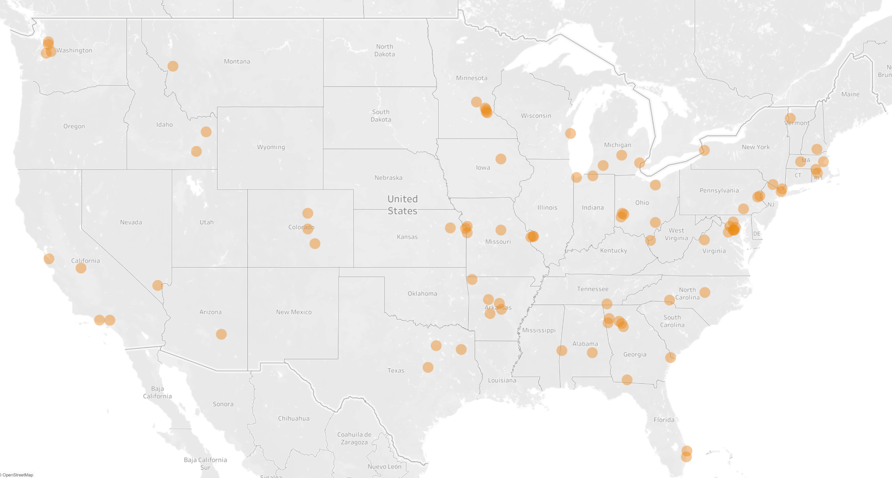
Bootcamps have supported 90 cities with winning $225 million to date
Pocatello, ID (pop. 56,016)
$8.5M from Reconnecting Communities to reconfigure an overpass and connect two neighborhoods with downtown
Athens, OH (pop. 24,978)
$12.5M from Charging and Fueling to install EV charging stations
Small City Winners Profile (<25k)
11,734
13.1%
Average population
Average poverty rate
$3,231,717
27%
Average award size
Of all Bootcamp winners
Globe, AZ (pop. 7,351)
$124k from Safe Streets to develop increase safety in the downtown district
Thomasville, GA (pop. 18,530)
$175k from Safe Streets to develop a multimodal transportation plan
4
Notes:
Katie: Let me start with why we did this. The National League of Cities and our partners saw that, historically, small and disadvantaged cities were missing out on competitive grant opportunities.
So we created a program for cities under 150,000 that is led by three North Star Goals:
First, shift who is applying for and who is winning these infrastructure grants away from the big cities, to small and mid-size cities that have been historically disinvested in.
Next, improve the quality of those applications so that they become WINNING applications.
Finally, help cities use this funding to make infrastructure and climate improvements in towns, villages and boroughs all across the nation.

Slide 5
Winners from all across the Country
Juneau, AK | $653,520
Ketchikan, AK | $75,300
Montgomery, AL | $36,663,000
Bentonville, AR | $121,190
Conway, AR | $125,490
Hot Springs, AR | $76,460
Little Rock, AR | $245,540
Globe, AZ | $124,846
Palo Alto, CA | $141,790
Pasadena, CA | $759,200
Thousand Oaks, CA | $12,000,000
Arvada, CO | $163,520
Pueblo, CO | $161,870
Woodland Park, CO | $220,000
West Palm Beach, FL | $174,630
Cedartown, GA | $160,000
Clarkston, GA | $1,000,000
Rome, GA | $76,460
Sandy Springs, GA | $166,910
Savannah, GA | $1,800,000
Thomasville, GA | $175,000
Woodstock, GA | $76,200
Dubuque, IA | $2,000,000
Waterloo, IA | $750,000
Rexburg, ID | $2,000,000
Pocatello, ID | $8,500,000
East St. Louis, IL | $218,880
Gary, IN | $129,280
South Bend, IN | $157,480
Mission, KS | $160,000
Amherst, MA | $76,440
Chelsea, MA | $280,000
Gaithersburg, MD | $360,000
Brentwood, MD | $160,000
Mount Rainier, MD | $9,764,000
Sykesville, MD | $160,000
Dearborn, MI | $24,894,430
Meridian, MI | $76,480
Portage, MI | $76,800
Apple Valley, MN | $114,820
Burnsville, MN | $123,700
Maple Lake, MN | $134,576
Richfield, MN | $76,260
St. Louis Park, MN | $114,140
Belton, MO | $200,000
Belton, MO | $60,000,000
Columbia, MO | $249,546
Columbia, MO | $176,550
Columbia, MO | $3,610,708
North Kansas City, MO | $240,000
St. Louis, MO | $330,620
Webster Groves, MO | $2,198,280
Missoula, MT | $308,000
Missoula, MT | $134,040
Gastonia, NC | $400,000
Holly Springs, NC | $76,320
Manchester, NH | $163,660
Henderson, NV | $307,600
Buffalo, NY | $293,740
Mount Vernon, NY | $296,000
Warwick, NY | $406,167
White Plains, NY | $126,510
Athens, OH | $12,545,691
Dayton, OH | $187,930
Germantown, OH | $1,070,338
Lagrange, OH | $211,685
Trotwood, OH | $337,000
Bethlehem, PA | $9,939,191
Easton, PA | $120,000
Lancaster, PA | $122,800
Providence, RI | $227,730
Woonsocket, RI | $76,470
Gladewater, TX | $240,000
Mesquite, TX | $256,000
Waco, TX | $187,120
Fairfax, VA | $400,000
Harrisonburg, VA | $117,870
Burlington, VT | $1,176,800
Burien, WA | $112,300
Everett, WA | $169,950
Issaquah, WA | $76,450
Mill Creek, WA | $160,000
Sheboygan, WI | $200,000
Huntington, WV | $76,800
Majority of Winners are Under 50K pop
Majority of Winners Have No Dedicated Grant Staff
Notes:
List by state, with cities, with amounts
Include states with $0
Average award
Small cities

Slide 6
Registration Open for Next Phase, Begins Early September
5 bootcamps
Rebuilding American Infrastructure with Sustainability and Equity
Building Resilient Infrastructure
Flood Mitigation Assistance
IRA Elective Pay
Drinking Water State Revolving Fund
Register NOW at www.localinfrastructure.org/application-bootcamp

Slide 7
Rebuilding American Infrastructure with Sustainability and Equity (RAISE)
Provides investments in road, rail, transit, and port projects to enhance freight and passenger transportation networks.
These projects will ultimately strengthen supply chains, reduce bottlenecks, and make local communities safer and more efficient for drivers, cyclists, and pedestrians.
Projects might include the development of master plans, zero emissions plans, reducing conflicts in residential areas between freight and traffic, development of port planning, and risk assessments.

Slide 8
Building Resilient Infrastructure and Communities (BRIC)
Assists communities as they undertake hazard mitigation projects, reducing the risks they face from disasters and natural hazards.
The program aims to shift the federal focus away from reactive disaster spending and instead focusing efforts on proactive investment in community resilience.

Slide 9
Flood Mitigation Assistance (FMA) program
Supports local communities through investments in strategies to harden resilience, in plans for flood mitigation, and in the reduction of the risk of damage before a disaster.
Projects might include reducing flood losses by elevation and relocation of flood insured structures, along with floodproofing non-residential structures, small local flood reduction projects, and plans to reduce flood damage.

Slide 10
IRA Direct Pay
The Inflation Reduction Act (IRA) includes a provision that provides non-taxable entities investing in clean energy with a direct payment option instead of tax credits.
Local leaders can utilize direct pay as an option for developing clean energy project. Projects may include clean energy generation, battery storage, community solar projects, electric vehicle (EV) charging infrastructure, and/or purchasing clean vehicles for fleets.

Slide 11
Drinking Water State Revolving Fund
Funding from state governments that local governments can use to address urgent water challenges, like strengthening drinking water and wastewater systems.

Slide 12
Registration Open for Next Phase, Begins Early September
5 bootcamps
Rebuilding American Infrastructure with Sustainability and Equity
Building Resilient Infrastructure
Flood Mitigation Assistance
IRA Elective Pay
Drinking Water State Revolving Fund
Register NOW at www.localinfrastructure.org/application-bootcamp

